Slide 1
Super store marketing campaign
(2012-2015)

Slide 2
Team-Group18
Team Names:
Anil Nimma (11597397)
Hari Krishna Thunga (11616021)
Sowmya Kondeti (11596944)
Lawrence Abhinav Gunkonda (11528114)

Slide 3
Appendix
Requirements
Input Data
Exploratory Data Analysis
Model
Results

Slide 4
Requirement
A superstore is planning for the year-end sale. They want to launch a new offer - gold membership that gives a 20% discount on all purchases. It will be valid only for existing customers and the campaign through phone calls is currently being planned for them. The management feels that the best way to reduce the cost of the campaign is to make a predictive model which will classify customers who might purchase the offer.

Slide 5
Input Data
Input Sample Data

Slide 6
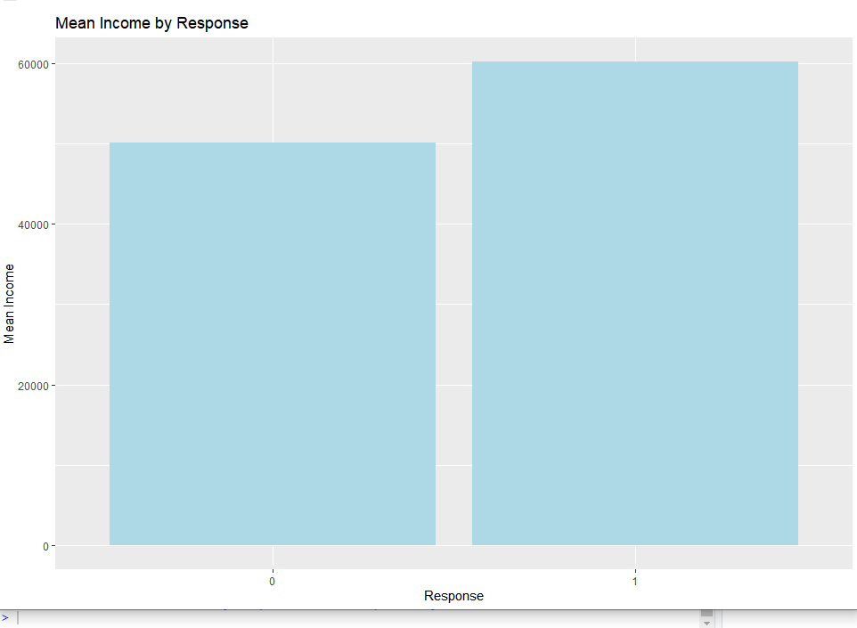
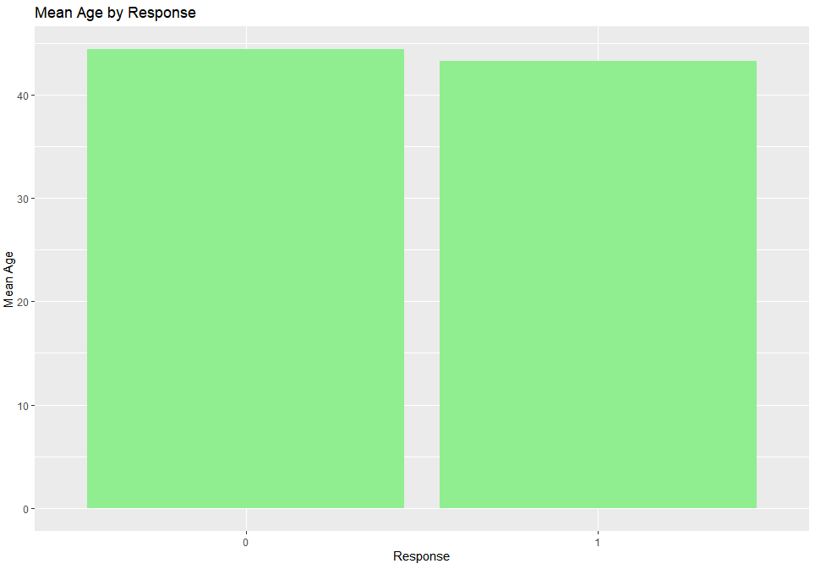
Exploratory Data analysis
Mean Income by Response
Mean Age by Response
The mean Income of control group is 50110.53
The mean Income of Target group is 60209.68
The mean age of controlled group is 44 Years
The mean age of Target Group is 43 Years

Slide 7
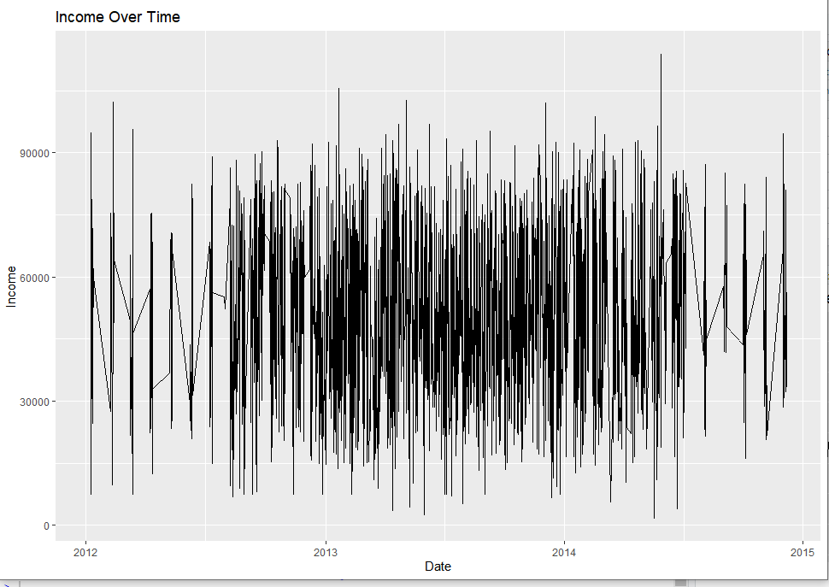
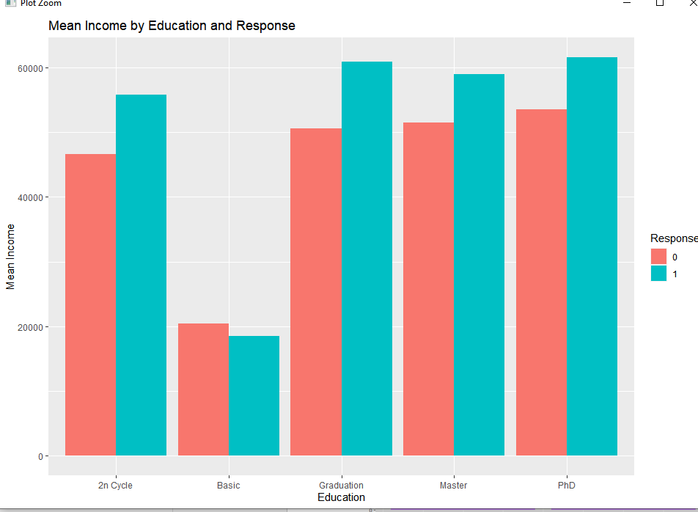
Exploratory data analysis
Mean Income by Education and Response
Income over Time
Most of the Transactions are take place in the year 2013 and 2014.
And also we can see there is volatility in revenue or Income.
The Graduates and PhD having higher income or revenue.

Slide 8
Architecture Of the model
Income
Kidhome
TeenHome
Recncy
…….
……..
……..
Response
Age
Response ~ Income + Kid Home+Teen_home_mntMeat+
…
……..
+age
Input Data
Logistic Regression
0-Control group
1-Target Group
Output data

Slide 9
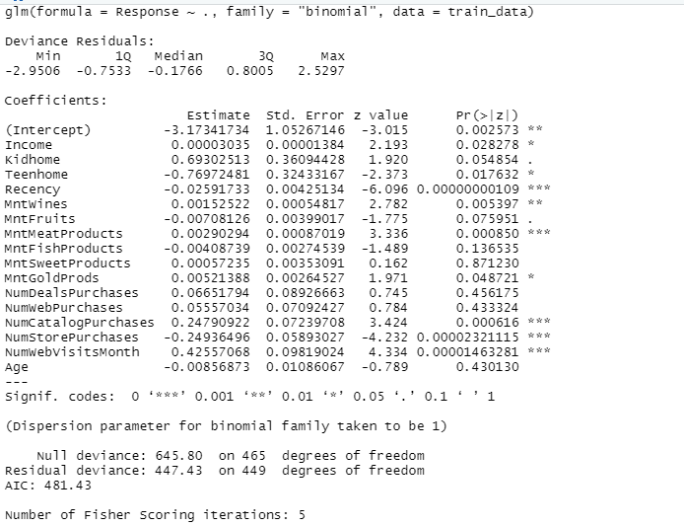
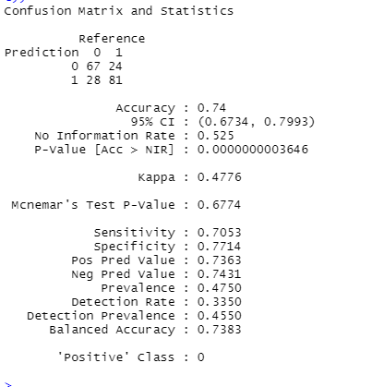
Result of model

Slide 10
Conclusion
Overall, the logistic regression model performed well in predicting whether a customer will fall into the target or control group. However, there is room for improvement, and we recommend additional data and analysis to refine the model further.
Potentially out of 237 control group customers 58 (25%) customers may turn to target group if we aim marketing at the customers.
Out of 229 target customers 59 customers may churn and fall into control group we can aim marketing campaign to not to lose these customers.

